Slide 1
Works about Controlled Text Generation
Bran

Slide 2
Table of Content
Controlled Text Generation
PPLM
GYC Framework
Discussion

Slide 3
Table of Content
Controlled Text Generation
PPLM
GYC Framework
Discussion

Slide 4

What is controlled text generation
Text generation: $p\left(y | x\right) or p(y)$
Controlled text generation: $p\left(y | x, c\right) or p(y|c)$
[Negative] I am sad today.

Slide 5
Lists
1. Plug and Play Language Models: a Simple Approach to Controlled Text Generation
Dathathri et al. Uber AI, ICLR 2020
2. Generate Your Counterfactuals: Towards Controlled Counterfactual Generation for Text
Nishtha Madaan, et al. IBM Research AI, AAAI 2021

Slide 6
Table of Content
Controlled Text Generation
PPLM
GYC Framework
Discussion

Slide 7
PPLM
Plug and Play Language Models: a Simple Approach to Controlled Text Generation
Dathathri et al. Uber AI, ICLR 2020
Input : an attribute a which we want the output x to have
Output: the target sentence x
[Negative] I am sad today.
Motivation:
How to train the model quickly when there is a new attribute $a_{new}$

Slide 8
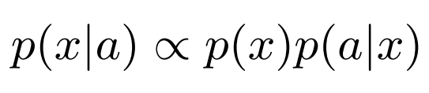
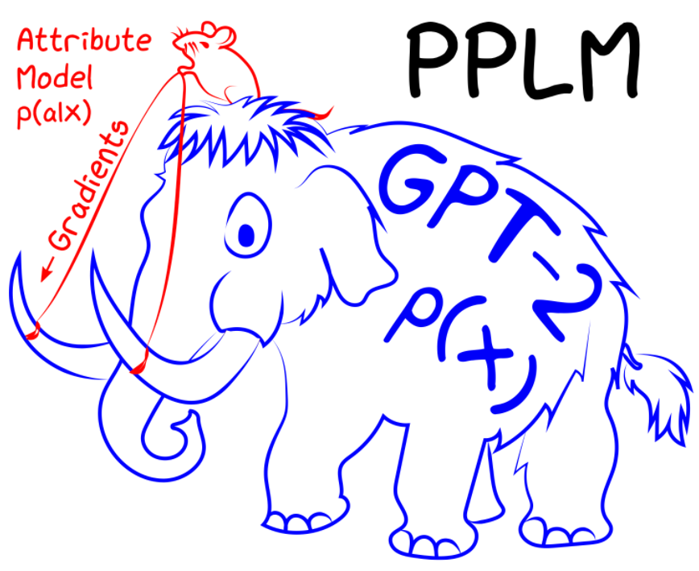

PPLM
maximize$log⁡(p\left(x\right))+log⁡(p(a|x))$
Notes:
We can use a trained LM, so for a new attribute a, we don’t’ need to change the LM, we only need to change attribute model
We only need to train a classifier for each attribute a and don’t change the pretrained LM

Slide 9
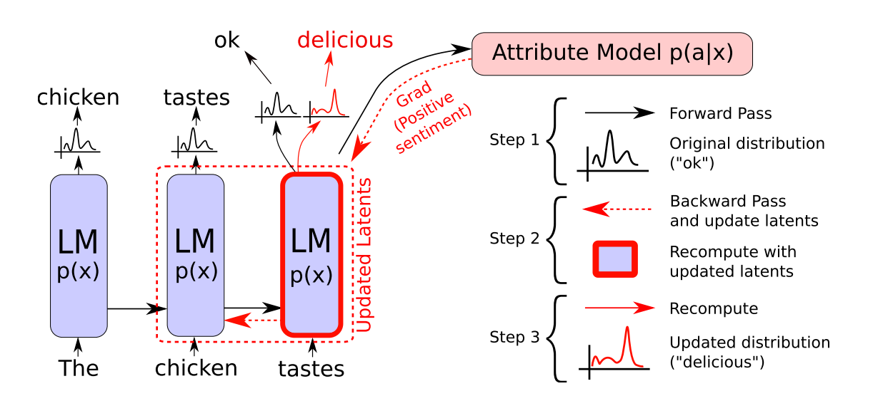

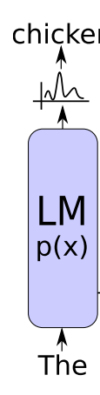





Ascending Log(p(a|x))
$$o_{t+1}, H_{t+1}=LM(x_{t}, H_{t})$$
$${\tilde{H}}_{t}←H_{t}+∆H_{t}$$
$$x_{t+1}\sim Categorical(o_{t+1})$$
Quiz: Can we use any classifier p(a|x) in this framework?
Notes:
Let’s see how to increase the probability p(a|x) when we generate sentences
Idea is we can update the H

Slide 10
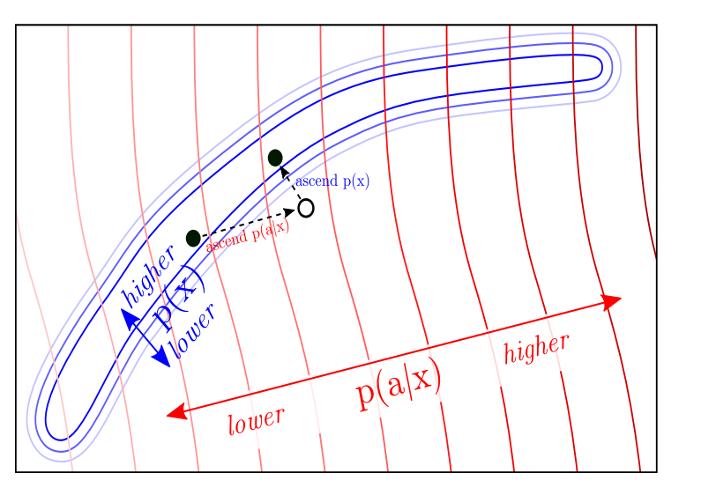
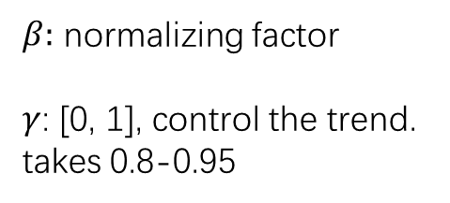
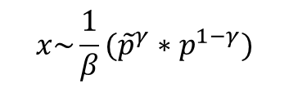
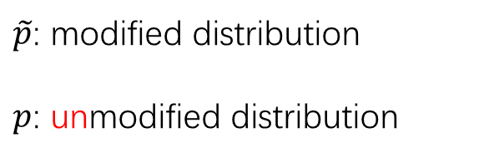

Ascending Log(p(x))
KL Divergence:
“good good good good good”
$$\log\left(a | x\right)− \sum_{t}{D_{KL}[p(x_{t}|x_{t−1}, {\tilde{H}}_{t−1})||p(x_{t}|x_{<t})]}$$
Positive
Post-norm Geometric Mean Fusion:
$$x\sim \frac{1}{β}({\tilde{p}}^{γ}∗p^{1−γ})$$
$\tilde{p}$: modified distribution
$p$: unmodified distribution
$β:$ normalizing factor
$γ$: [0, 1], control the trend. takes 0.8-0.95
Sampling
Notes:
After ascending p(a|x), we find p(x) decreases
Two steps -> add log probability , one step, word by word instead of sample all sentence
KL: measure the distance between unmodified LM and modified LM

Slide 11
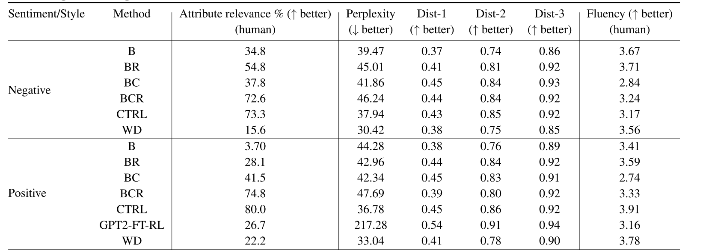
Experiments
Parameters : 1.6B (CTRL) vs 1K/attribute (BCR)
Notes:
15 different prefix x to generate

Slide 12
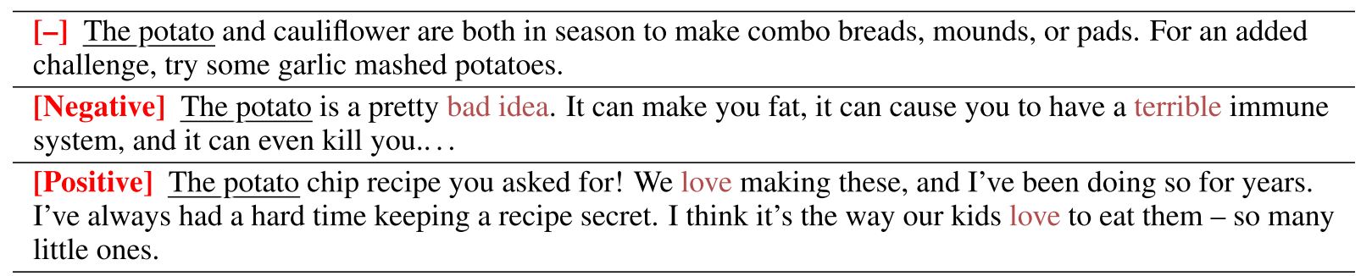
Examples

Slide 13
Table of Content
Controlled Text Generation
PPLM
GYC Framework
Discussion

Slide 14

What is counterfactual ?
Generate Your Counterfactuals: Towards Controlled Counterfactual Generation for Text Nishtha Madaan, et al. IBM Research AI, AAAI 2021
Counterfactual text is a synthetically generated text that an AI model is forced to treat differently. Counterfactual text is used to test AI models.
My boss is a man.
Positive
My boss is a woman.
Negative
Sentiment analysis

Slide 15
Conditions
Model: NER Location Tagger
Model: Sentiment Classifier
My friends lives in beautiful London.
I am very disappointed with the service.
Perturb Location
Negative
My friend lives in majestic downtown Chicago.
I am very pleased with the service.

Slide 16
Previous Works
plausible
Templates based
Adversarial Attack
GPT2
diverse
Can we use pplm on this task?
1. GPT2 is not good at inference, which is $p(y|x)$
2. Do not support non-differentiable model $p(a|y)$

Slide 17
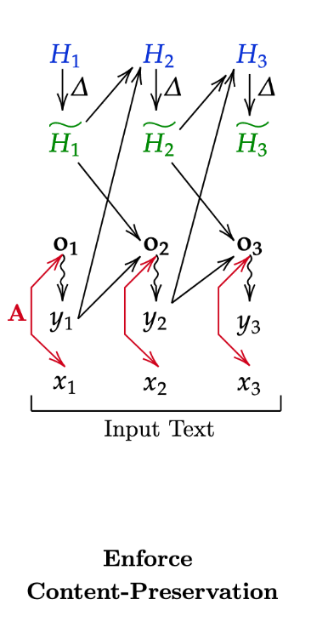


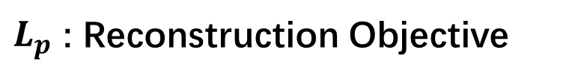
$L_{p}$ : Reconstruction Objective
Because in this task we only need to change a few words in the sentence
We can let the model to predict the input text x at first.

Slide 18
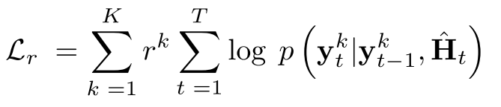
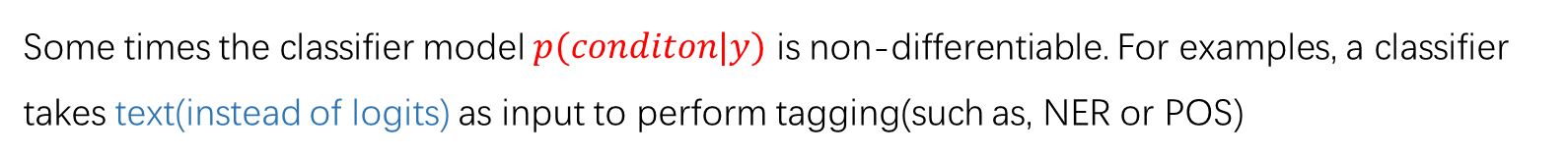
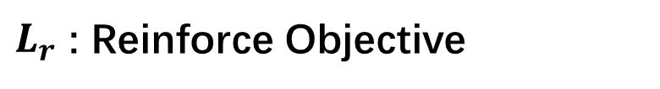
$L_{r}$ : Reinforce Objective
Some times the classifier model $p(conditon|y)$ is non-differentiable. For examples, a classifier takes text(instead of logits) as input to perform tagging(such as, NER or POS)
Draw K samplings based on current ${\hat{H}}_{t}$. $r^{k}$is the reward from classifier model of k-th sample.

Slide 19
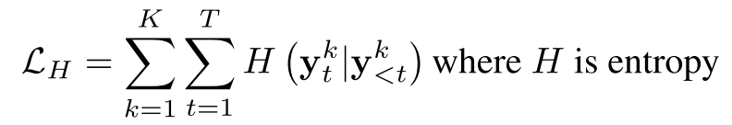
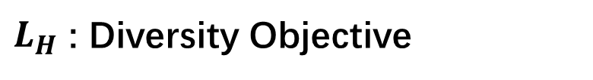
$L_{H}$ : Diversity Objective

Slide 20
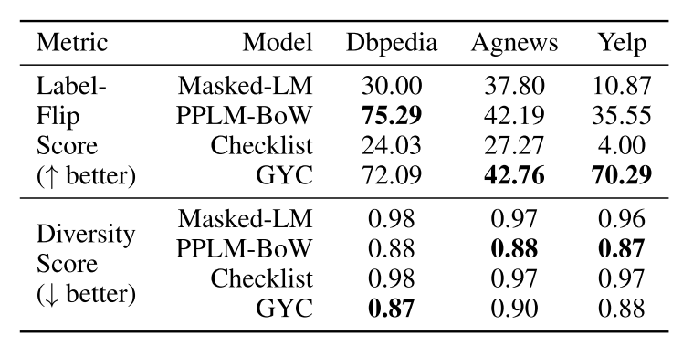
Experiments
Dataset:
DBPedia: location and organizations dataset, 14 classes, 560K samples
AgNews: real-word news, 4 classes, 120K samples
Yelp: sentiment analysis, 2 classes, 600K samples
Test model: XLNet

Slide 21
Table of Content
Controlled Text Generation
PPLM
GYC Framework
Discussion

Slide 22
Discussion
1. PPLM is a effective model for generation task. It reduces the training time and generates comparable results.
2. GYC is similar to PPLM, but it can be used for inference tasks.
Next
1. When the input text is short, the classifier can not judge it well
2. We can try some other generative model like BART which performs well on inference tasks.

Slide 23
Thanks!

